Slide 1
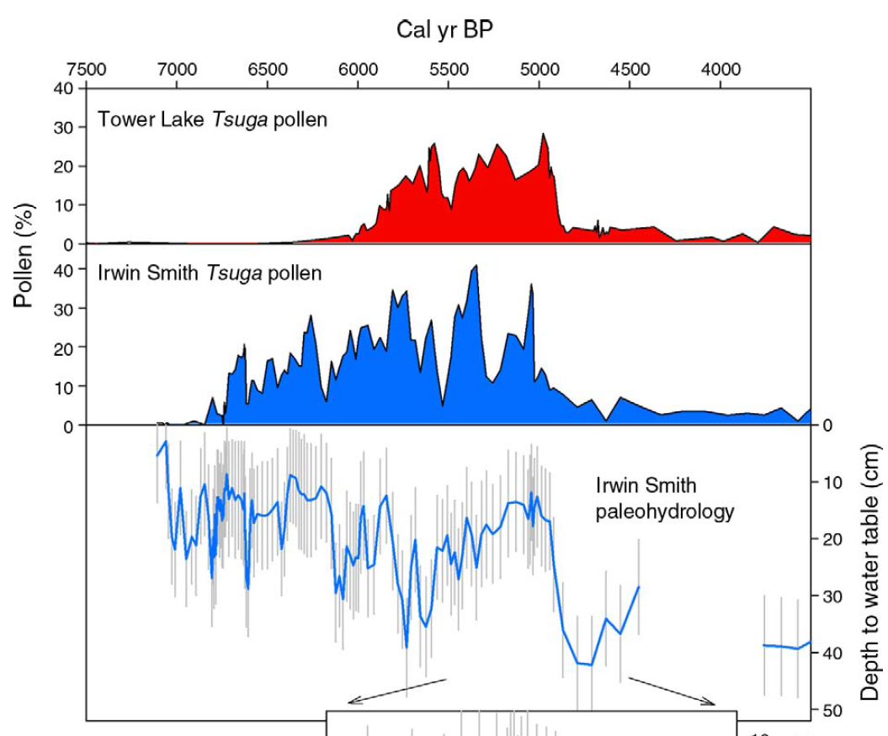
Booth et al. 2012 Ecology

Slide 2
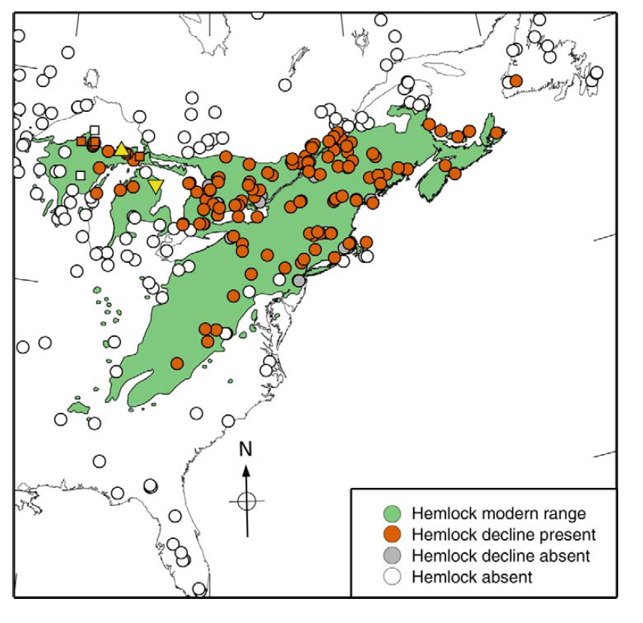
Are these declines all abrupt?
Are they synchronous?
Are they all in fact the same ecological event, with similar forcings?
What kind of statistical power can we gain from studying one(?) event at many places?
How were these data collected?
How can we analyze many data from many sites?
Booth et al. 2012 Ecology

Slide 3
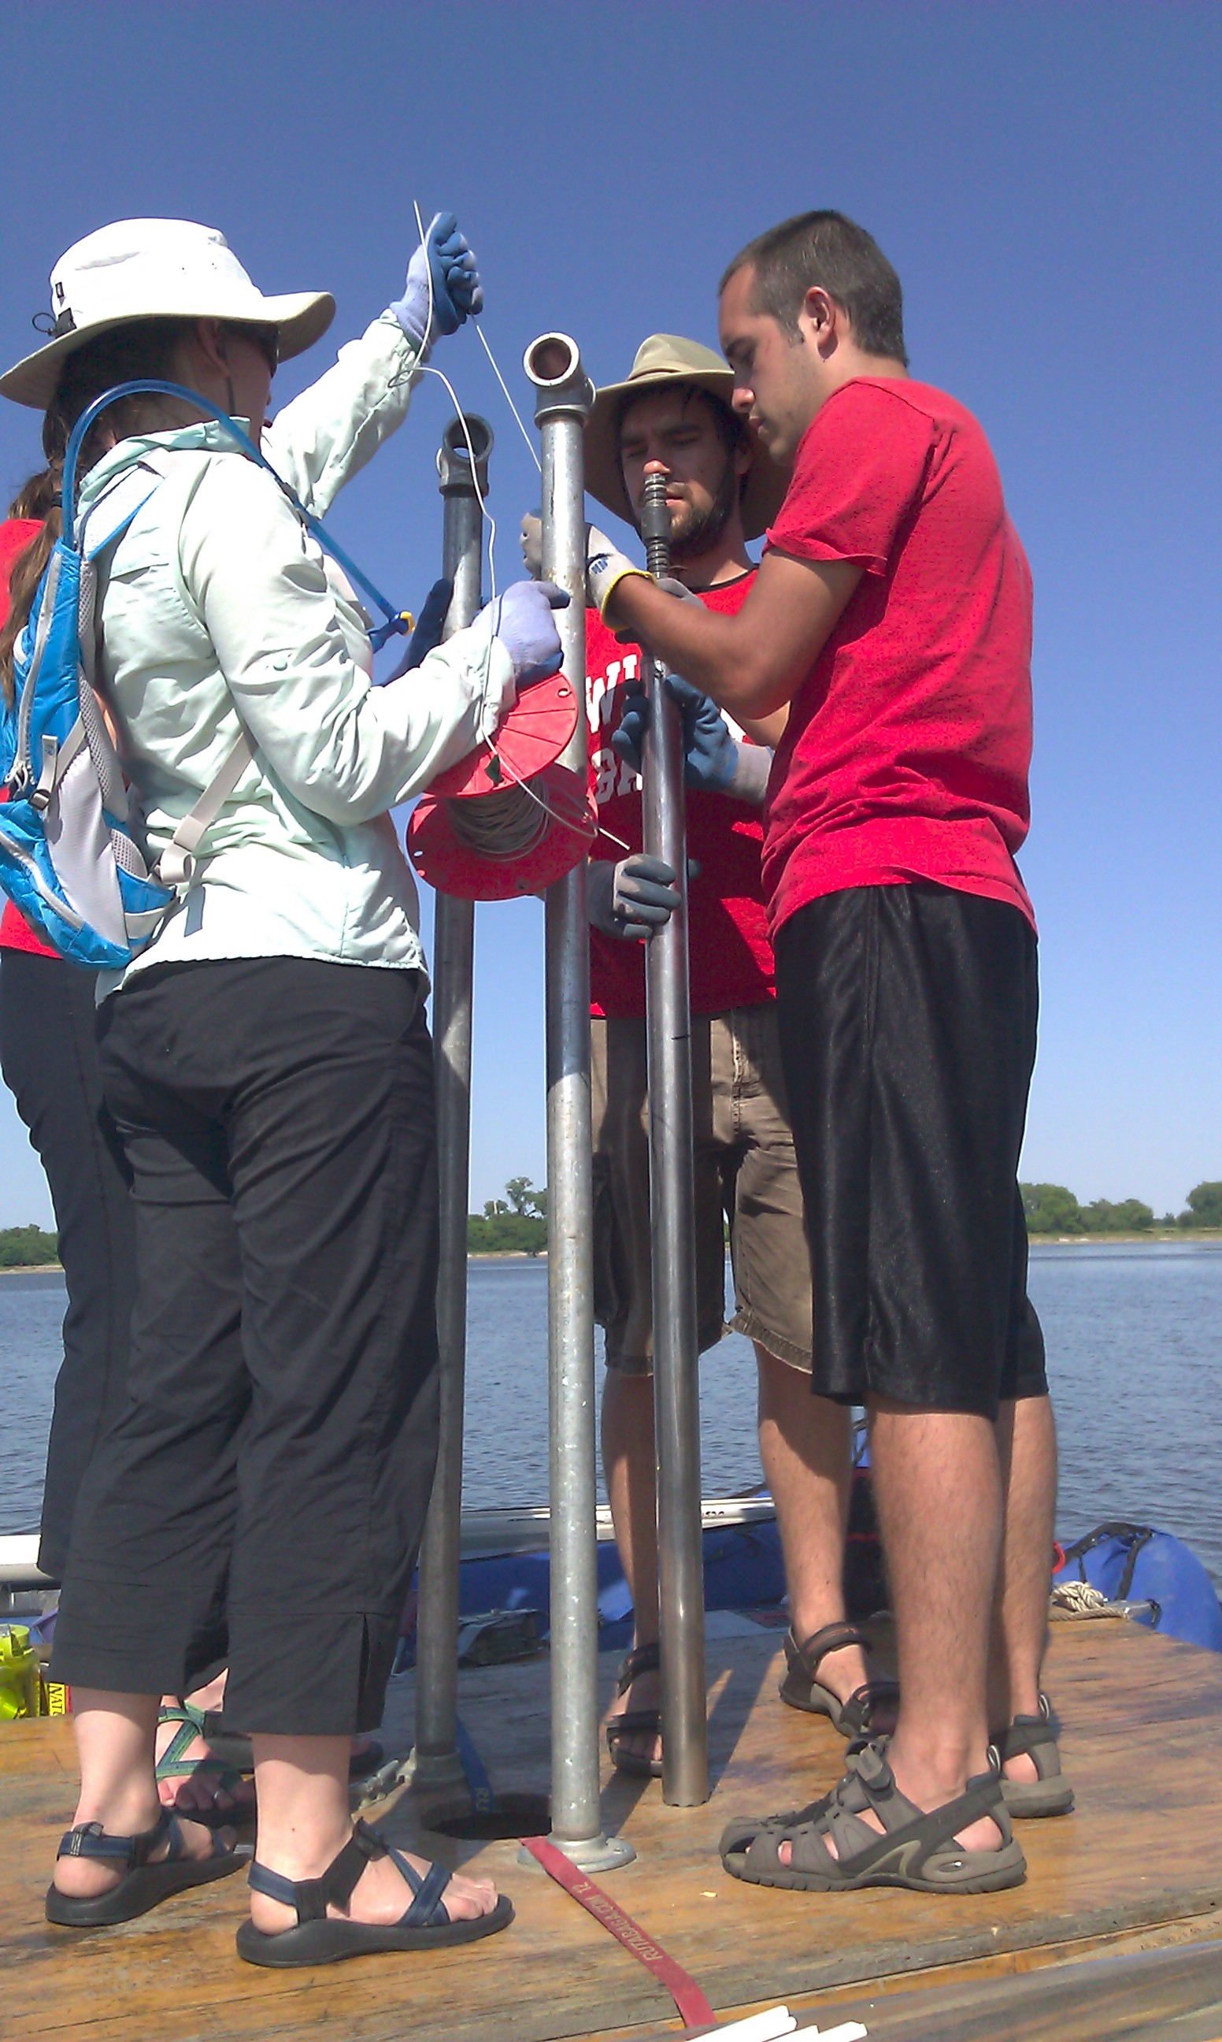
Coring Horseshoe Lake, IL

Slide 4
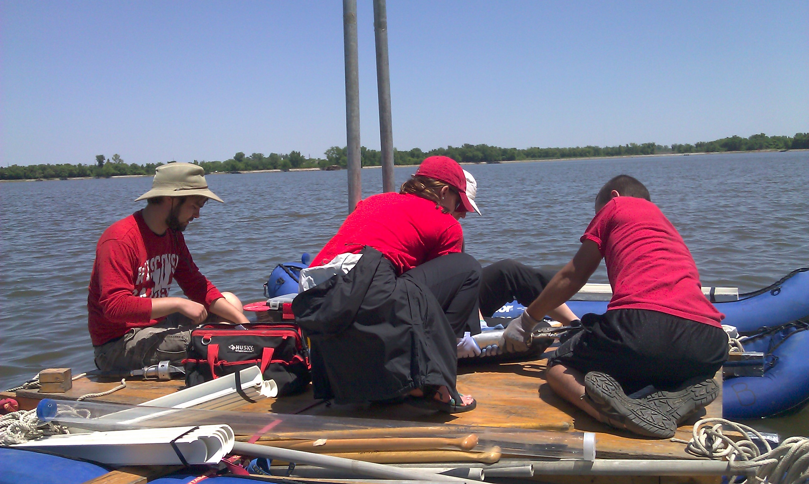
Extruding Core

Slide 5
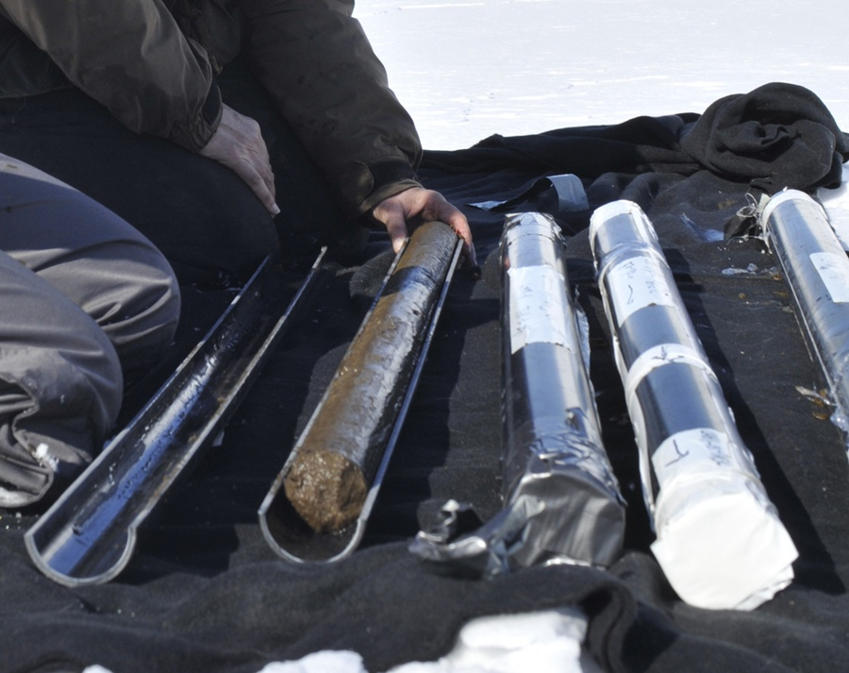
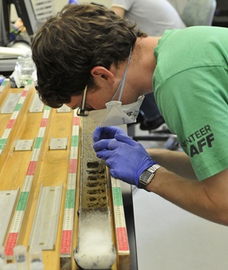
Cores, Sampling
Jessica Marshall
Jessica Marshall

Slide 6
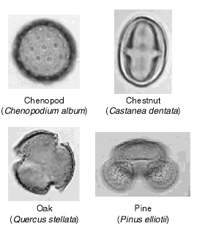
Primary data: Fossil pollen records
Transport
Advantages
Quantitative measures of abundance
Temporally continuous
Precise ages: often <100 yr precision
Many sites
Multiple proxies (charcoal, isotopes, biomarkers, etc.)
Pollen
Emission
Deposition
Sample Pollen Grains
Lake
Limitations
Labor intensive
Variable taxonomic resolution (species – family)
~Decadal resolution
Incomplete and biased census of vegetation
Mud

Slide 7
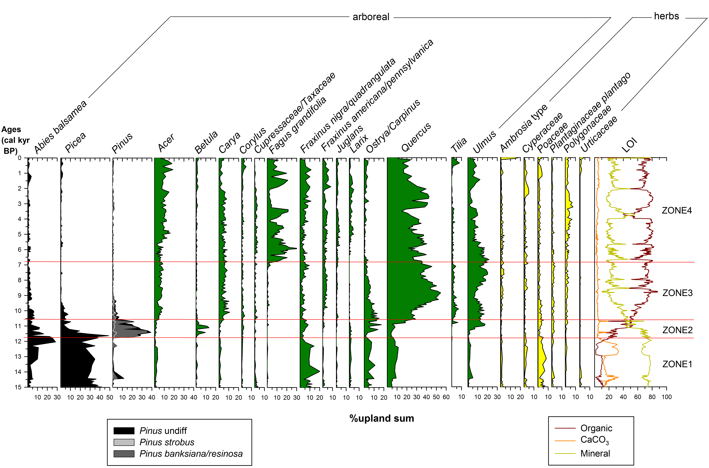
Fossil Pollen Diagram
Balsam fir
Beech
Oak
Spruce
Pine
Wang et al. 2015 The Holocene

Slide 8
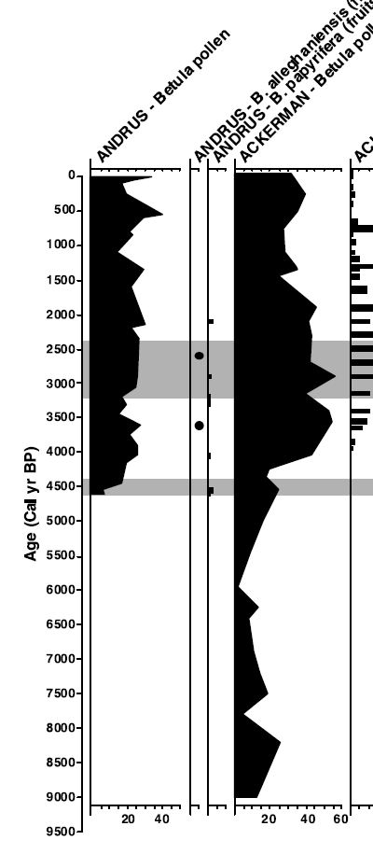
Dating and Age Model Uncertainty
For geologists, time is an unknown variable. It must be estimated. It has uncertainty.
Critical evaluation of age estimates and age models is fundamental to good inference in the paleogeosciences
Timing of Yellow Birch expansion
– Jackson & Booth 2002

Slide 9
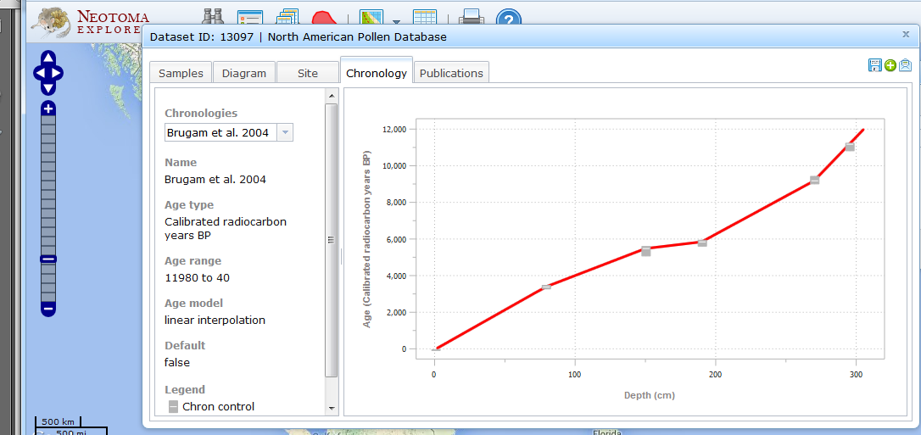
Terminology
Age Control: an estimate of absolute age, often with a specified uncertainty, for a sample within a core or stratigraphic profile that is used to constrain an age model.
Glimmerglass Lake
Source: Grimm et al. 2014 Age Models, Chronologies, and Databases Workshop: Complete Report and Recommendations. PAGES Workshop Report. Queens University, Belfast.

Slide 10
Terminology
Age-Depth Model: an algorithm used to estimate the age-depth relationship for a series of stratified paleoenvironmental data points. Age-depth models are used to make estimates of ages for depths not directly associated with an age control or to resolve discrepancies among age controls.
Glimmerglass Lake
Source: Grimm et al. 2014 Age Models, Chronologies, and Databases Workshop: Complete Report and Recommendations. PAGES Workshop Report. Queens University, Belfast.

Slide 11
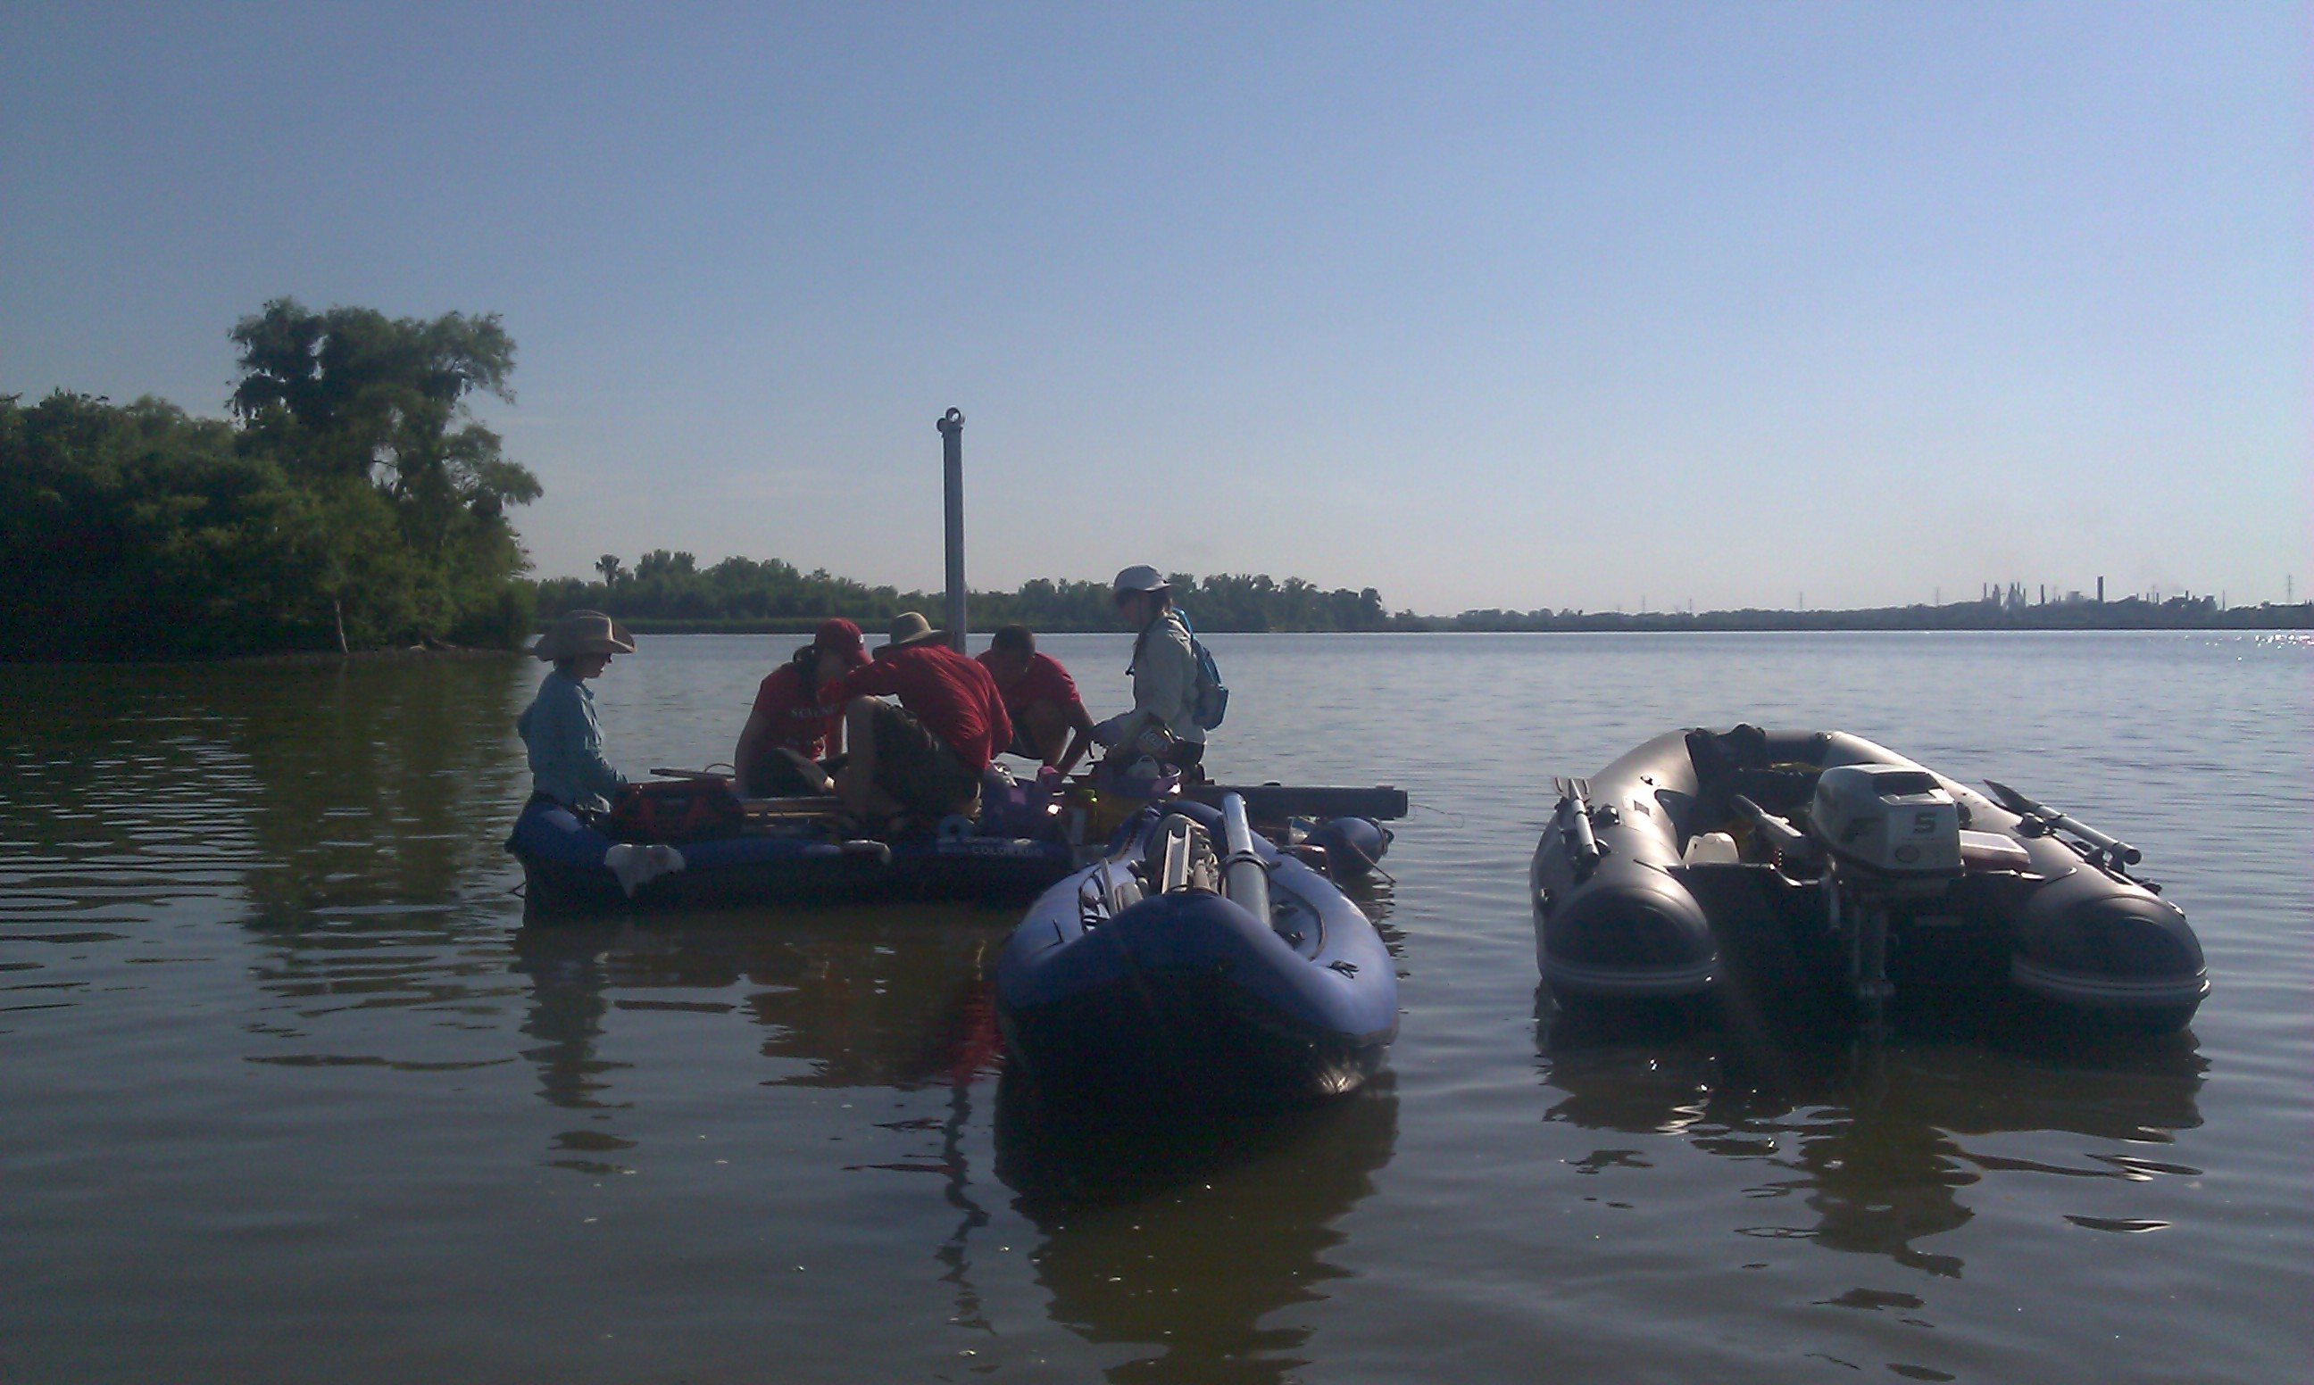
Part 1 – Questions?

Slide 12
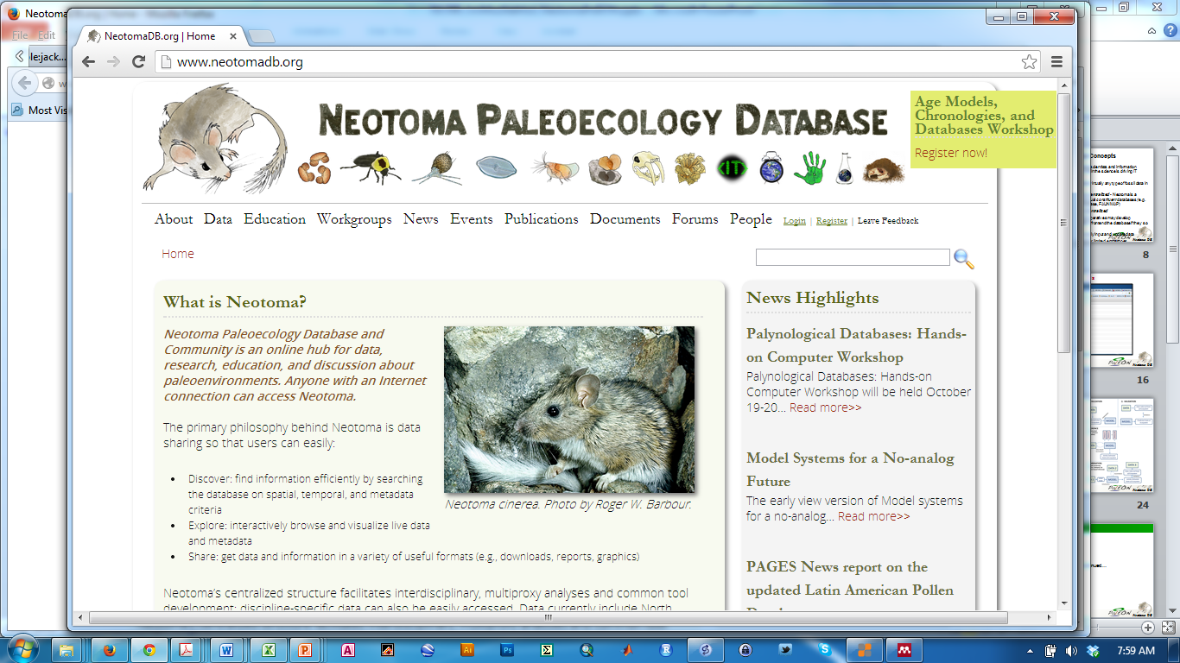
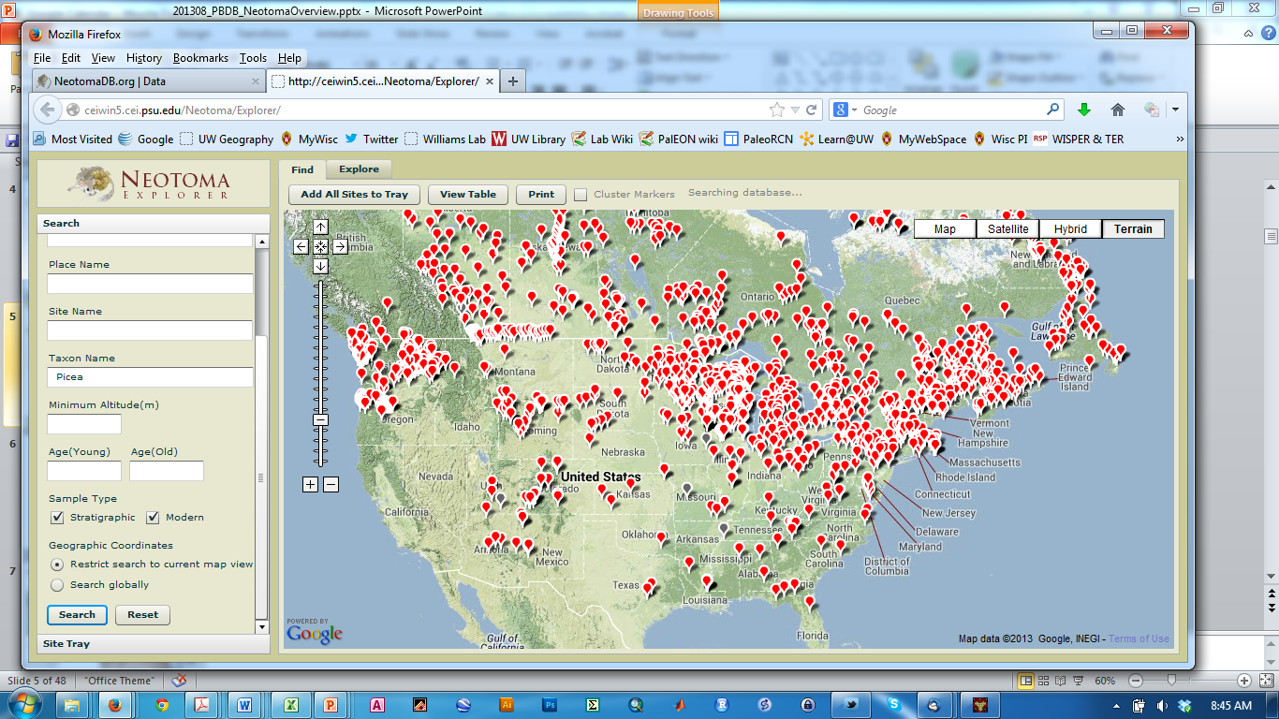
Part 2: Paleoecoinformatics & Neotoma Paleoecology Database

Slide 13
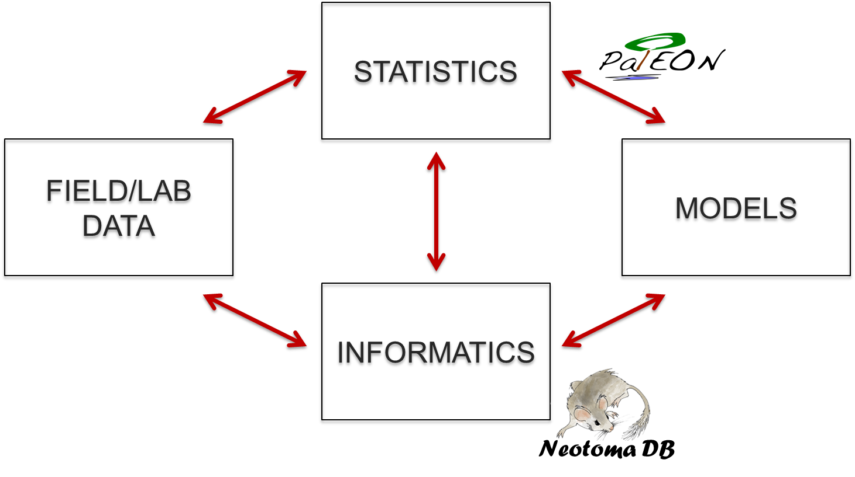
Macro-Scale Ecology Requires requires collaboration among at least four major groups

Slide 14
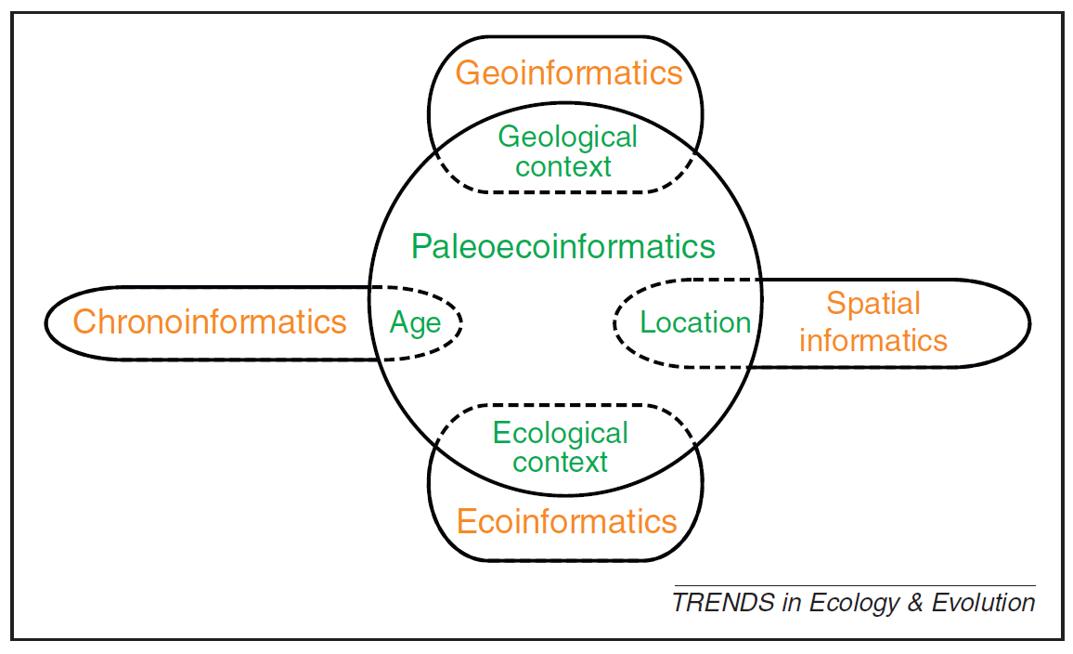
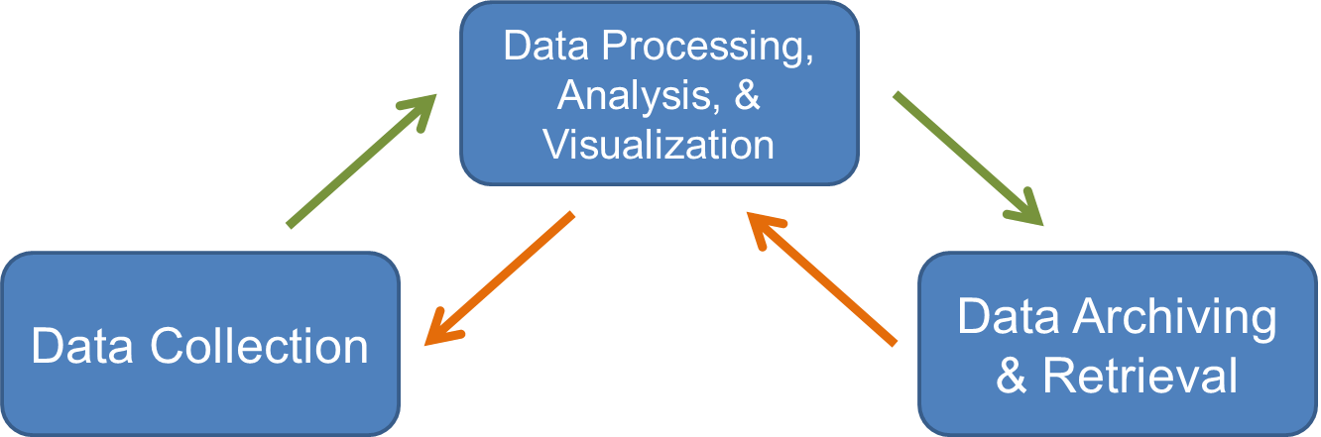
Informatics: designing systems that deliver the right information, to the right person in the right place and time, in the right way. (Wikipedia)
Paleoecoinformatics: the collection, organization, analysis, synthesis, and curation of paleoecological data
Brewer et al. 2012 TREE

Slide 15
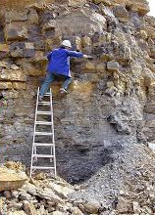
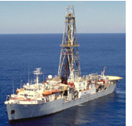
Paleodata: Key characteristics
‘Long Tail’: Collected in the field & lab by many individuals and scientific teams.
Heterogeneity: Many kinds of measurements & methods
Distributed Scientific Expertise by proxy type, archive type, region, time period, and/or taxonomic group
Commonality: All involve measurements of proxies in various geological archives by depth, from which we estimate time.
Long Shelf Life: specimens & samples collected decades ago can be re-analyzed
Bad News
Good News

Slide 16
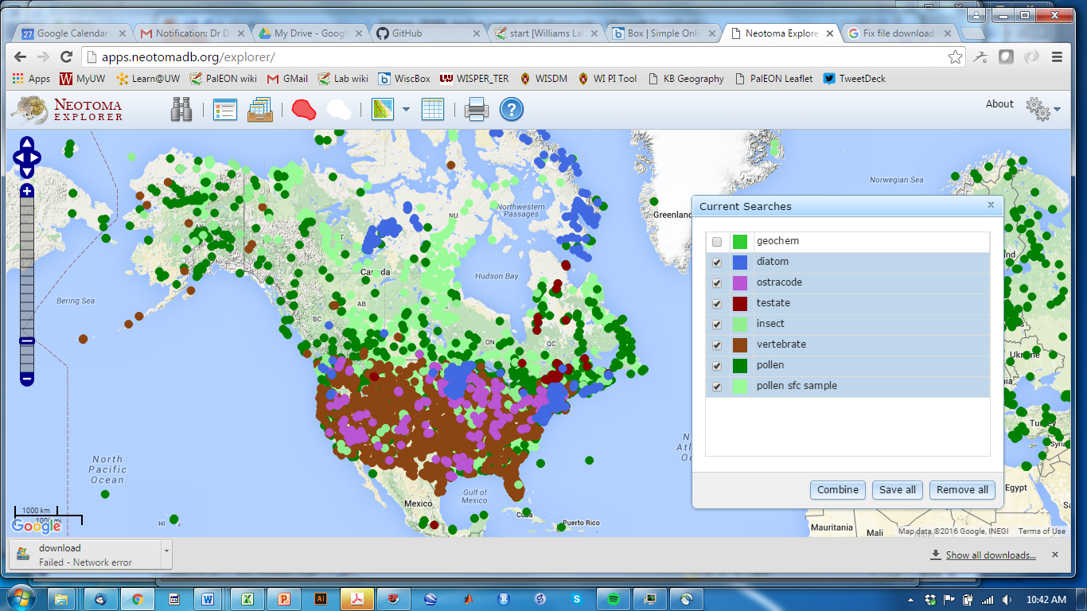
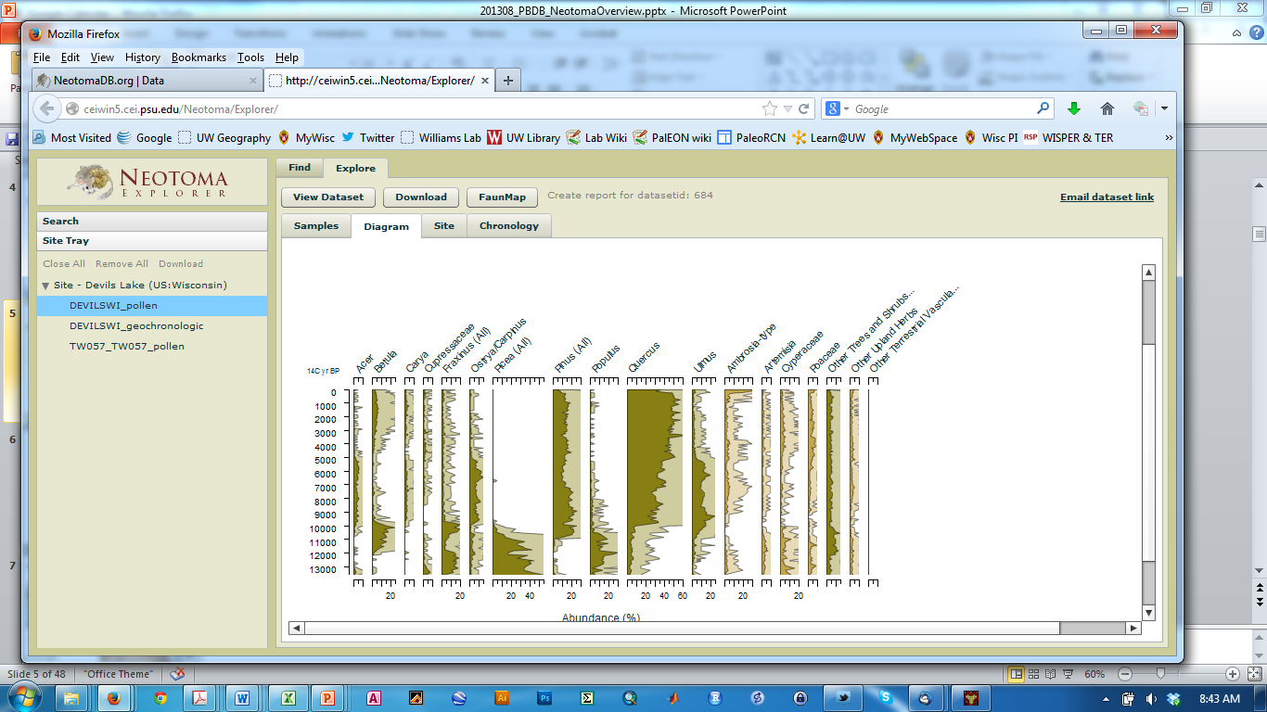
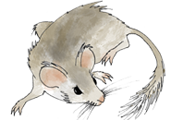
Neotoma Paleoecology DB: Design Concepts
Spatiotemporal database: species occurrences & abundances in space and time
Open data accessible via Explorer, APIs, R Neotoma
Curated by Community -> High-Value Data
Centralized IT and Distributed Scientific Governance. Neotoma composed of Constituent Databases (e.g. North American Pollen Database, FAUNMAP)
Age controls and age models stored
Controlled Vocabularies for variable names and taxonomy
Broad user community: Paleoecologists, ecosystem modellers, paleoclimatologists, biogeographers, educators, …
Neotoma DB
www.neotomadb.org

Slide 17
Neotoma Explorer (Finding/Exploring/Getting Data)
Neotoma DB
www.neotomadb.org
See also: Walk-Through Teaching Exercise, Neotoma Explorer
http://serc.carleton.edu/neotoma/activities.html

Slide 18
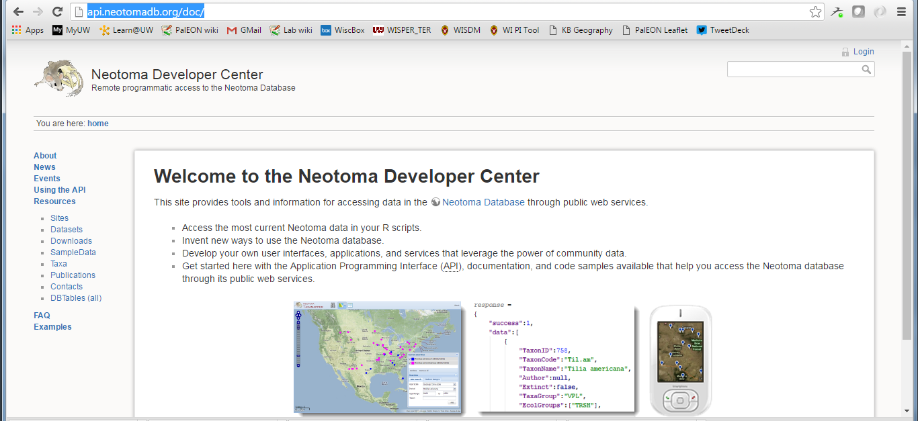
Neotoma APIs (Finding/Exploring/Getting Data)
Neotoma DB
www.neotomadb.org
APIs & Documentation available at:
http://api.neotomadb.org/doc/

Slide 19
Neotoma Resources
Neotoma APIs
http://api.neotomadb.org/doc/
Neotoma Explorer
http://apps.neotomadb.org/explorer/
Neotoma Manual, Design Concepts, etc.
http://neotoma-manual.readthedocs.io/en/latest/index.html
Walk-Through Teaching Exercise, Neotoma Explorer
http://serc.carleton.edu/neotoma/activities.html
Tilia
Download: http://www.tiliait.com/download/
Manual: http://tilia-manual.readthedocs.io/en/latest/
Neotoma R
Available at CRAN & GitHub - https://github.com/ropensci/neotoma
Goring et al. 2015 Open Quaternary

Slide 20
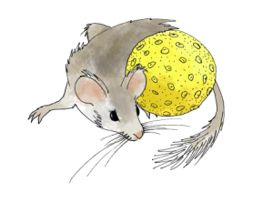
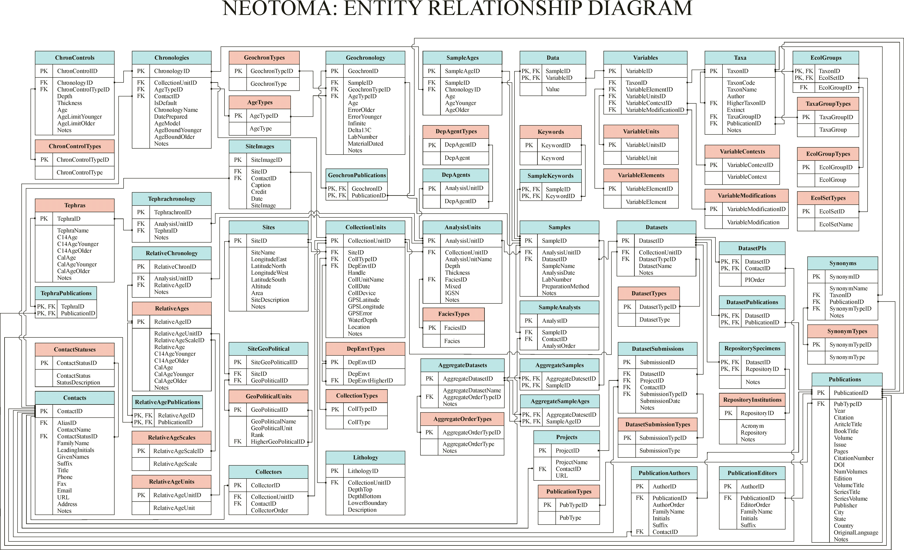
Neotoma Concepts & Database
Database Structure

Slide 21
Key Concepts: Sites, Collection Units, Analysis Units, Samples, Datasets
Sites
CollectionUnits
AnalysisUnits
Samples
Datasets
SiteID
SiteName
LongitudeEast
LatitudeNorth
LongitudeWest
LatitudeSouth
Altitude
Area
SiteDescription
Notes
CollectionUnitID
SiteID
CollTypeID
DepEnvtID
Handle
CollUnitName
CollDate
CollDevice
GPSLatitude
GPSLongitude
GPSError
WaterDepth
Location
Notes
AnalysisUnitID
CollectionUnitID
AnalysisUnitName
Depth
Thickness
FaciesID
Mixed
IGSN
Notes
SampleID
AnalysisUnitID
DatasetID
SampleName
AnalysisDate
LabNumber
PreparationMethod
Notes
DatasetID
CollectionUnitID
DatasetTypeID
DatasetName
Notes
One site may have many collection units
One collection unit may have many analysis units
One analysis unit may have many samples
A dataset comprises all samples of same type from same collection unit

Slide 22
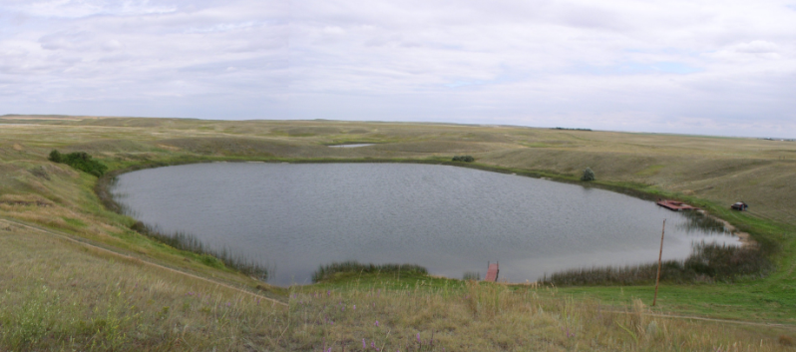
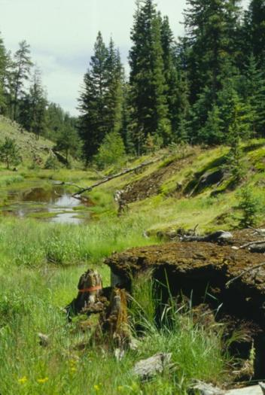
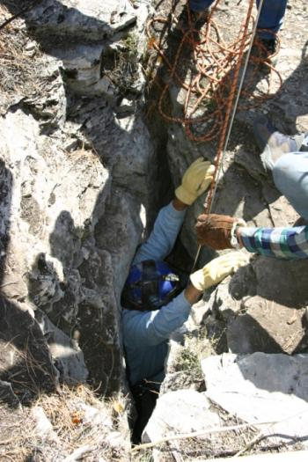
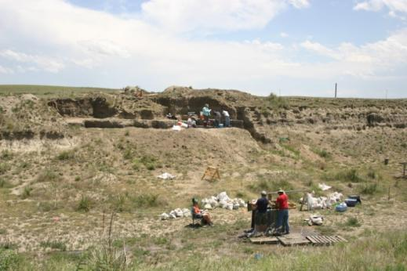
Sites
Sites Table
Lakes
SiteID
SiteName
LongitudeEast
LatitudeNorth
LongitudeWest
LatitudeSouth
Altitude
Area
SiteDescription
Notes
Sections
Caves
Archaeological Digs

Slide 23
Collection Units
Sites
CollectionUnits
Examples
Multiple cores w/in a lake
Multiple pits w/in an archaeological dig
Multiple bone piles within a cave
etc.
SiteID
SiteName
LongitudeEast
LatitudeNorth
LongitudeWest
LatitudeSouth
Altitude
Area
SiteDescription
Notes
CollectionUnitID
SiteID
CollTypeID
DepEnvtID
Handle
CollUnitName
CollDate
CollDevice
GPSLatitude
GPSLongitude
GPSError
WaterDepth
Location
Notes

Slide 24
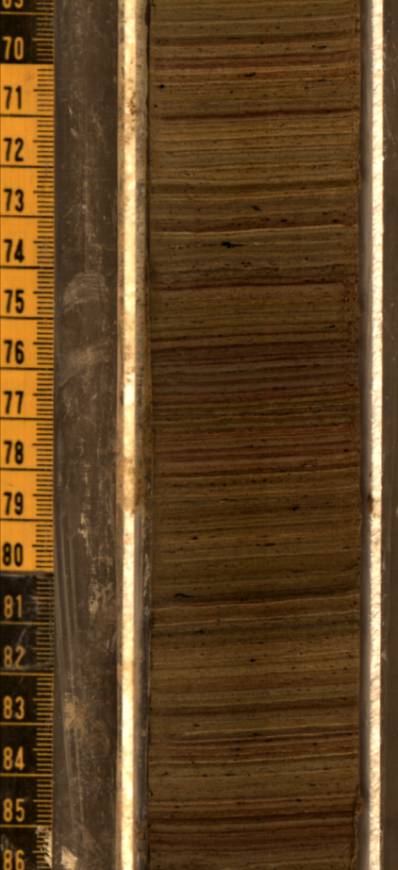
Analysis Units
CollectionUnits
AnalysisUnits
CollectionUnitID
SiteID
CollTypeID
DepEnvtID
Handle
CollUnitName
CollDate
CollDevice
GPSLatitude
GPSLongitude
GPSError
WaterDepth
Location
Notes
AnalysisUnitID
CollectionUnitID
AnalysisUnitName
Depth
Thickness
FaciesID
Mixed
IGSN
Notes
Analysis units have a depth and thickness
Example: depths within a sediment core

Slide 25
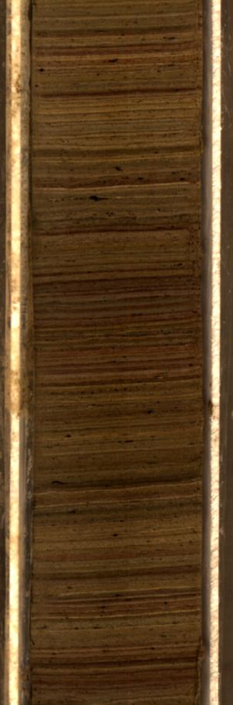
Samples
AnalysisUnits
Samples
AnalysisUnitID
CollectionUnitID
AnalysisUnitName
Depth
Thickness
FaciesID
Mixed
IGSN
Notes
SampleID
AnalysisUnitID
DatasetID
SampleName
AnalysisDate
LabNumber
PreparationMethod
Notes
Pollen
Charcoal
Diatoms
Loss-on-ignition
Example: pollen, charcoal, diatom samples from a single depth interval in a core

Slide 26
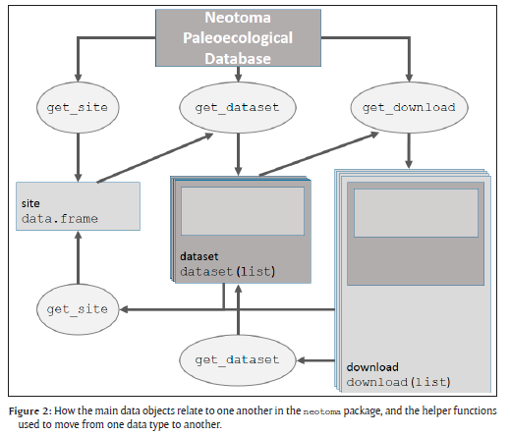
Neotoma R Porting Neotoma data to R environment
Key Functions
get_site
get_dataset
get_download
get_chroncontrol
get_table
get_taxa
Other Functions
get_closest
get_contact
get_publication
GitHub Repository: https://github.com/NeotomaDB/neotoma
Goring et al. 2015 Open Quaternary

Slide 28
Extra Slides

Slide 29
Paleoecoinformatics occupies the intersection among several informatics domains
Brewer et al 2012 TREE

Slide 30
Paleoecoinformatics: the collection, organization, analysis, synthesis, and curation of paleoecological data
Data Processing, Analysis, & Visualization
Data Collection
Data Archiving & Retrieval
Informatics: studying how to design a system that delivers the right information, to the right person in the right place and time, in the right way. (Wikipedia)

